Slide 1
Statistics of Enrichment Analysis
Reuben Thomas
Gladstone Bioinformatics Core
May 23rd – 24th , 2023

Slide 2
This workshop takes off where some of our other workshops left off
Introduction to Experimental Design and Hypothesis Testing
Statistical concepts
Introduction to Pathway Analysis (online tools)
Implementation of Enrichment Analysis methods
Introduction to Pathway Analysis Using R
Implementation of Enrichment Analysis methods plus visualization of results
Intermediate RNA-seq Using R
Possible next step after running gene expression association analysis
Introduction to R for Data Analysis
Language for implementing various Enrichment Analysis methods

Slide 3
Expectations for this workshop
Knowledge of basic statistics
Familiarity with one or more high-dimensional assays: RNA-seq, Mass-spec
Some experience working with R

Slide 4
Leading the discussions will be…
Reuben Thomas
Associate Director, Bioinformatics Core
Michela Traglia
Statistician III

Slide 5
Outline and main messages
Context and background for enrichment methods
Primer on statistics
Statistics of Enrichment Methods
Choice of Parameter of Interest/Test statistic
Choice of Null Hypothesis
Sampling distribution of the Test statistic
Overview of the specific enrichment methods
Demo of the some methods in R
Guide to your choice of the method for your application
Questions

Slide 6
Outline and main messages
Context and background for enrichment methods
Primer on statistics
Statistics of Enrichment Methods
Choice of Parameter of Interest/Test statistic
Choice of Null Hypothesis
Sampling distribution of the Test statistic
Overview of the specific enrichment methods
Demo of the some methods in R
Guide to your choice of the method for your application
Questions

Slide 7
Question 1
Have you used enrichment analyses methods in your work?
Respond to Poll

Slide 8
Question 2
Please name some of the enrichment methods you have used
Respond to Poll

Slide 9
Question 3
How well have you understood the statistics and assumptions of the methods you have used?
Respond to Poll

Slide 10
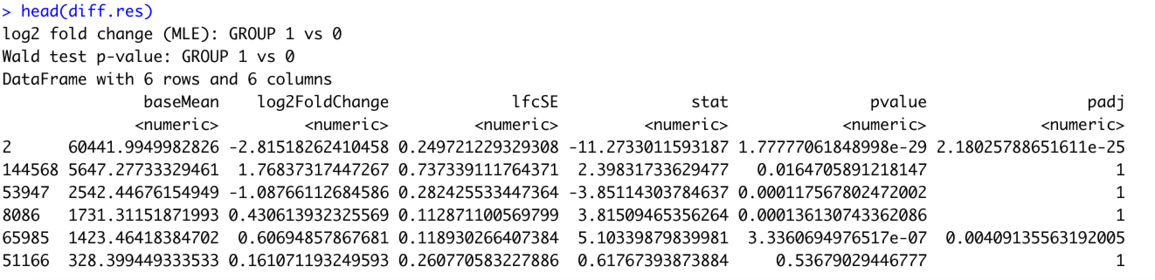
RNA-seq data for bladder cancer tumor vs normal patient samples
What pathways are differentially regulated in tumor vs normal tissue in bladder cancer patients?
PCA plot
Volcano plot

Slide 11
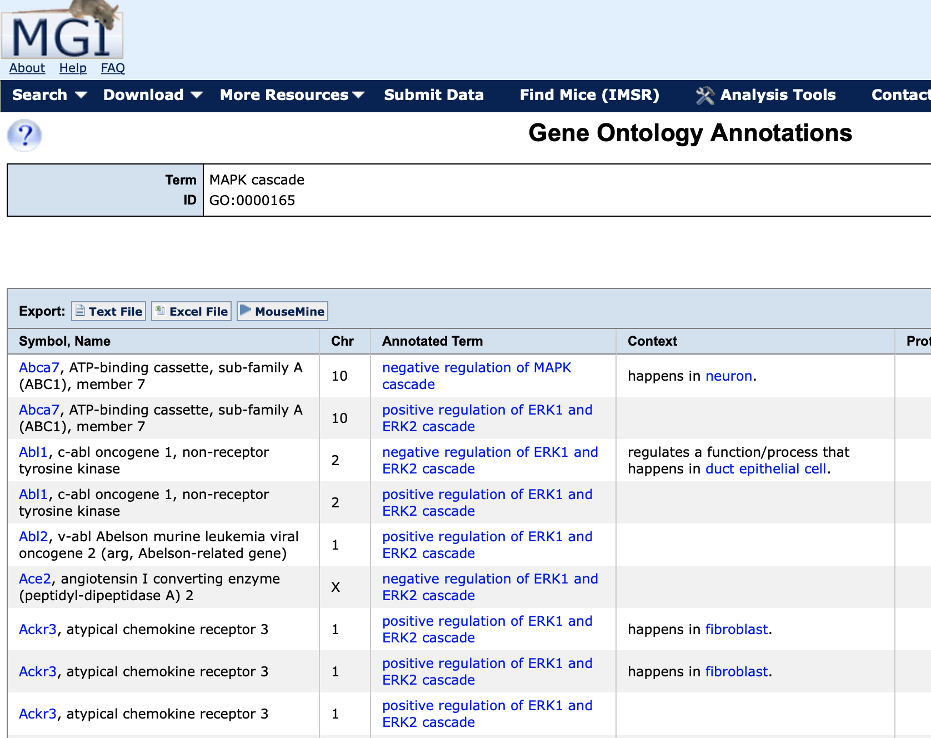
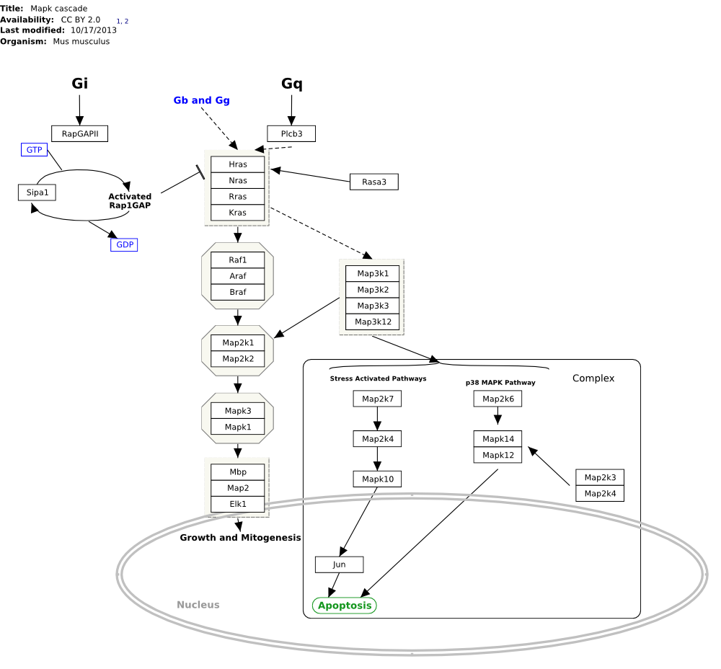
Pathways and Gene sets

Slide 12
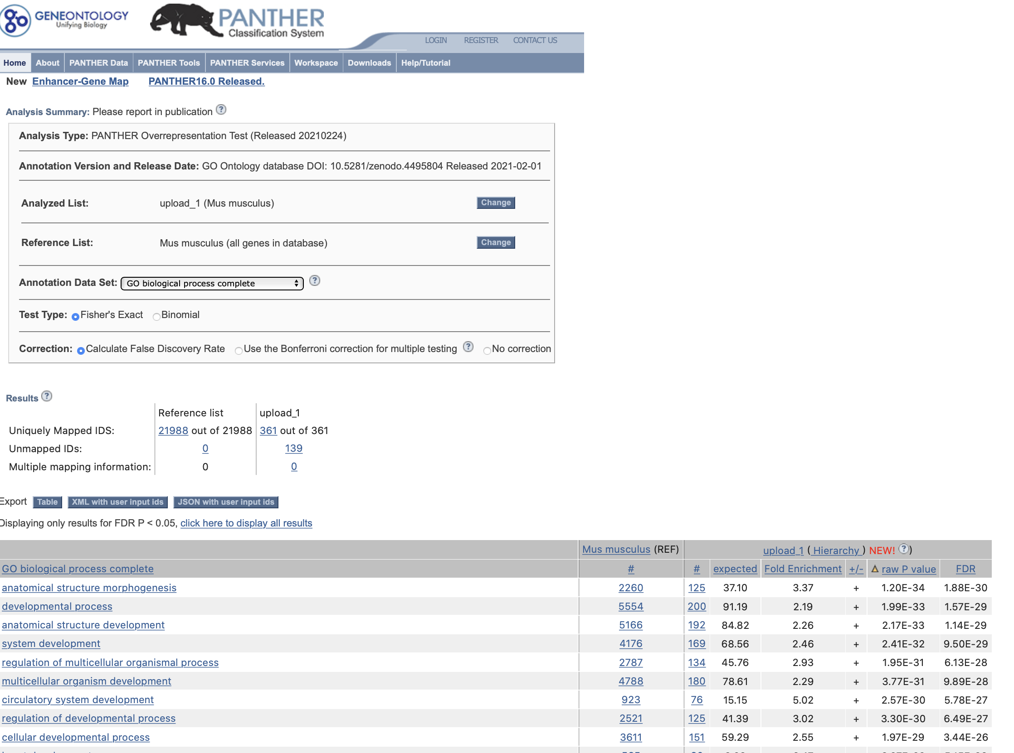
Pathway/gene set databases help us determine functional relevance of our high-throughput data
Databases
Gene Ontology (GO)
WikiPathways (WP)

Slide 13
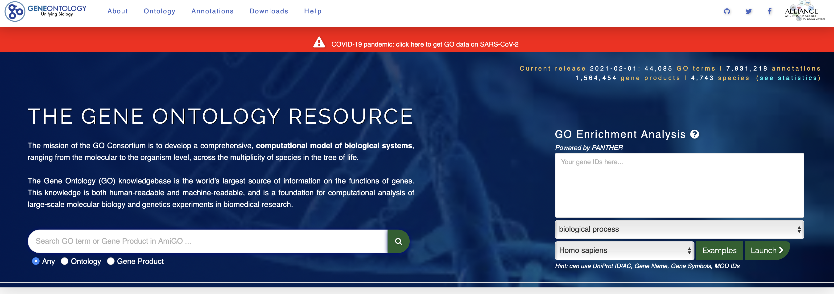
Gene ontology is a well-established source of gene sets
Started in 1998
Efforts from multiple research groups/consortia across the world
Over 30,000 gene sets attributed to biological processes, molecular functions and cellular components
Each gene set is just a “bag” of genes
http://geneontology.org

Slide 14
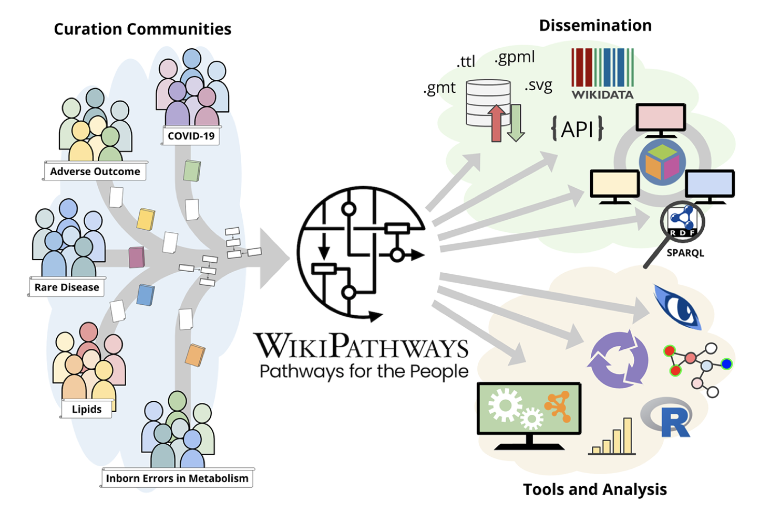
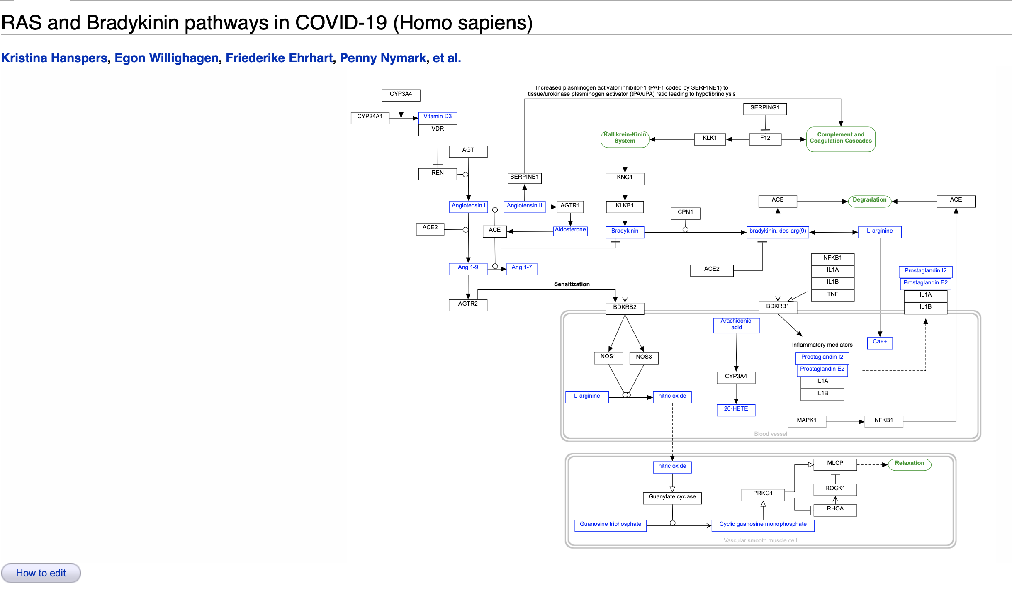
WikiPathways is a source of gene sets represented as pathways
Started in 2007
Open source, anyone can contribute to suggesting new pathways or curate existing ones
Over 1000 pathways/gene sets
Martens et al. Nucleic Acids Research, 2021, Vol. 49, Database issue
https://www.wikipathways.org/index.php/Pathway:WP4969

Slide 15
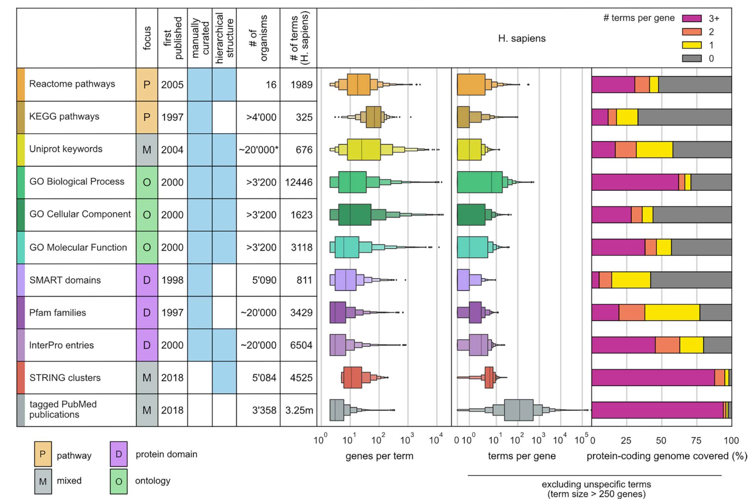
Gene set annotation systems differ widely in numbers and sizes of terms
Gable et al. 2022
Notes:
https://academic.oup.com/bib/article/23/5/bbac355/6695266

Slide 16
Various methods available for Enrichment Analyses
ORA: Over Representation Analyses
GSEA: Gene Set Enrichment Analyses
rSEA: Simultaneous Enrichment Analyses
SAFE: Significance Analyses of Function and Expression
PADOG: Pathway Analysis with Down-weighting of Overlapping Genes
Notes:
This site maintains a list of GSA tools: https://gsa-central.github.io/gsarefdb.html

Slide 17
Different numbers of bladder-cancer associated WikiPathways from different methods!
UpSet Plot
Six different methods evaluated with this data set
Some pathways are uniquely detected by one method
Why do different methods come up with different answers?
How does one decide on the right method to use for a given situation?
out of 568 WikiPathways

Slide 18
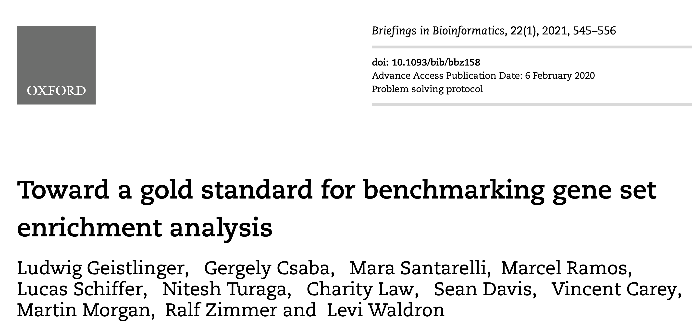
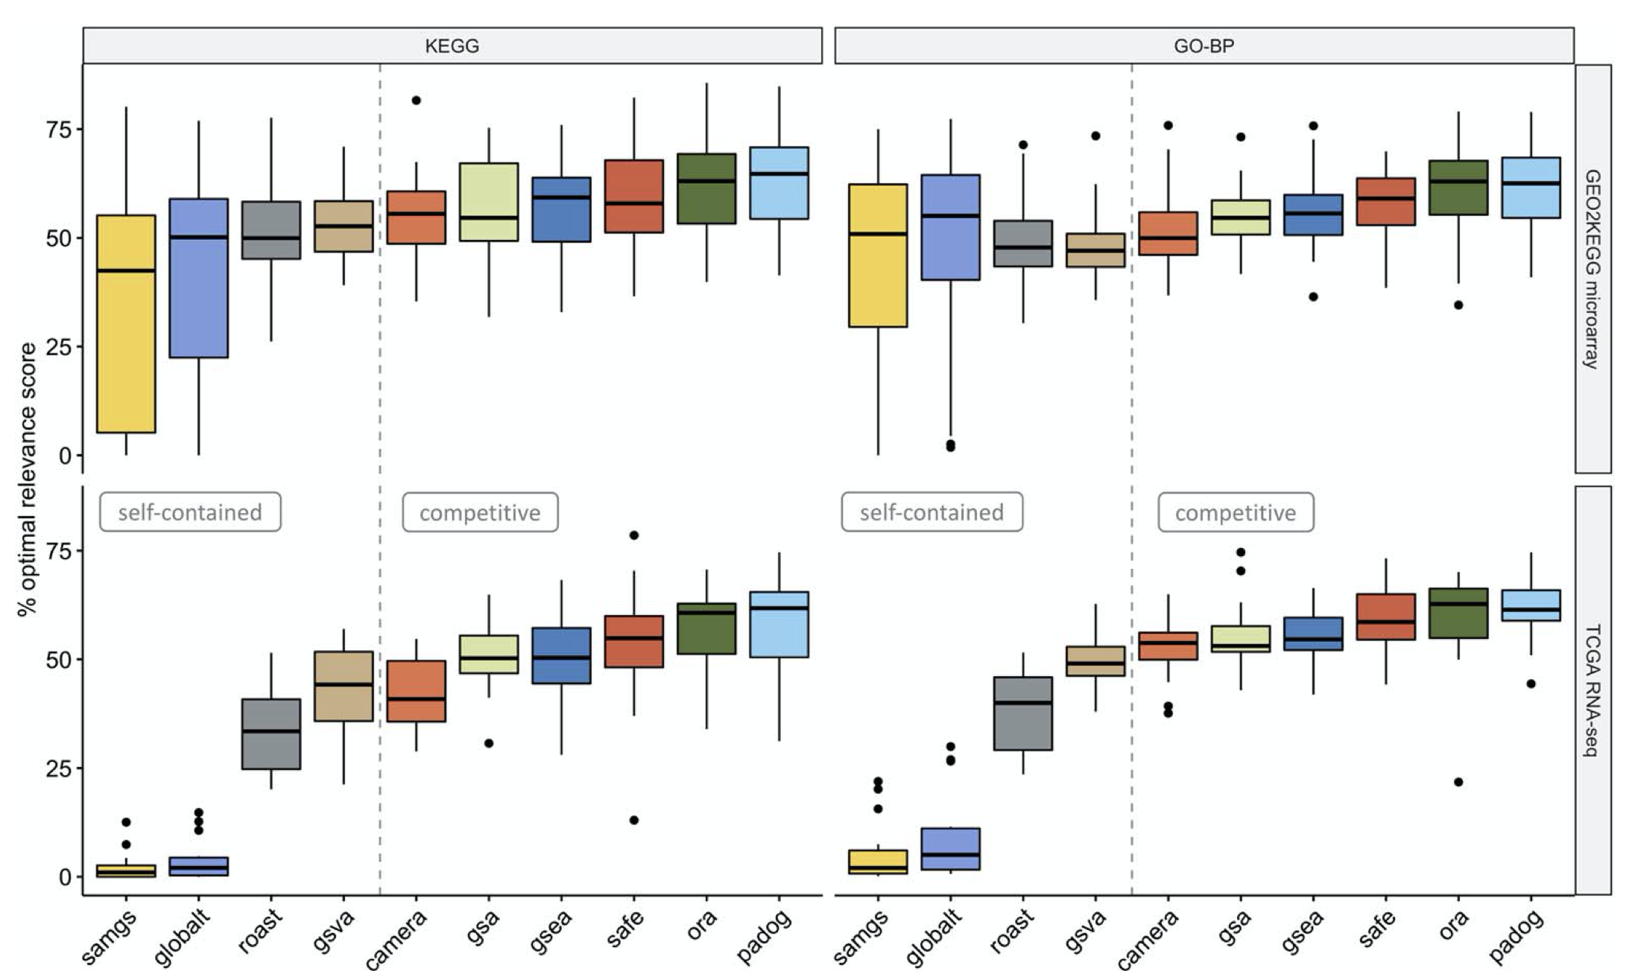
Check for recommendations in the literature!
Talk to the Gladstone Bioinformatics Core!
Listen to the rest of this session!

Slide 19
Outline and main messages
Context and background for enrichment methods
Primer on statistics
Statistics of Enrichment Methods
Choice of Parameter of Interest/Test statistic
Choice of Null Hypothesis
Sampling distribution of the Test statistic
Overview of the specific enrichment methods
Demo of the some methods in R
Guide to your choice of the method for your application
Questions

Slide 20
Primer on Statistics
We are all working under constraints of limited resources – time and money
We empirically study biological phenomena by conducting experiments
With limited resources we would like to make generalizable conclusions across all samples in our target population
The principles of statistics guide us in our experimental designs and give us hypothesis tests that allow us to make generalizable conclusions

Slide 21
Is a gene differentially expressed between two developmental time-points?

Slide 22
Primer on Hypothesis Tests
Null hypothesis holds the skeptical viewpoint that the observed changes are uninteresting/driven by random chance
Significance threshold represent your decision point when making claims as to whether the association you observe is real or not
Type I error measures the fraction of time one claims there is a real association when in fact it is driven by random chance
Parameter of interest captures that effect you are studying – fold-change, slope, difference of means
Test statistic captures deviation from the null/skeptical expectation
Sampling distribution captures the distribution of the test statistic over repeated experiments under the null hypothesis

Slide 23
Outline and main messages
Context and background for enrichment methods
Primer on statistics
Statistics of Enrichment Methods
Choice of Parameter of Interest/Test statistic
Choice of Null Hypothesis
Sampling distribution of the Test statistic
Overview of the specific enrichment methods
Demo of the some methods in R
Guide to your choice of the method for your application
Questions

Slide 24
Steps in coming up with a hypothesis test for Pathway Enrichment
Decide on a parameter of interest ~ what would capture the change in pathway activity?
Define the null hypothesis ~ Change in pathway activity = 0
Define a test statistic ~ e.g., Odds ratio, Proportion of affected genes
Identify the sampling distribution of the test statistic ~ e.g., Hypergeometric distribution
Characterize the Type I and II errors

Slide 25
Outline and main messages
Context and background for enrichment methods
Primer on statistics
Statistics of Enrichment Methods
Choice of Parameter of Interest/Test statistic
Choice of Null Hypothesis
Sampling distribution of the Test statistic
Overview of the specific enrichment methods
Demo of the some methods in R
Guide to your choice of the method for your application
Questions

Slide 26
Capturing pathway activity
Most assays we work with provide only relative quantification of gene expression, protein levels
We are interested in differential regulation (disease vs control, treated vs control) of pathways
Most pathways/gene sets are made of proteins signaling to each other, involved in metabolic conversion of substrates etc.
BIG incorrect assumption: Changes in gene expression are a good surrogate for changes in “pathway activity”
Despite this we push forward for the lack of better alternatives

Slide 27
How does one quantify changes in “pathway activity”?
“Large” proportion of altered genes/proteins in a given pathway
Increase in odds of an altered gene belonging to the pathway
Increase/decrease in the fold-changes of genes in the pathway

Slide 28
True Discovery Proportion (TDP)
TDP_{s}: fraction of genes is gene set, s associated with condition
TDP_{genome}
Point estimate: 0.53
95% confidence interval: (0.34, 1)
34% of all genes are altered in bladder cancer tumor vs normal samples

Slide 29
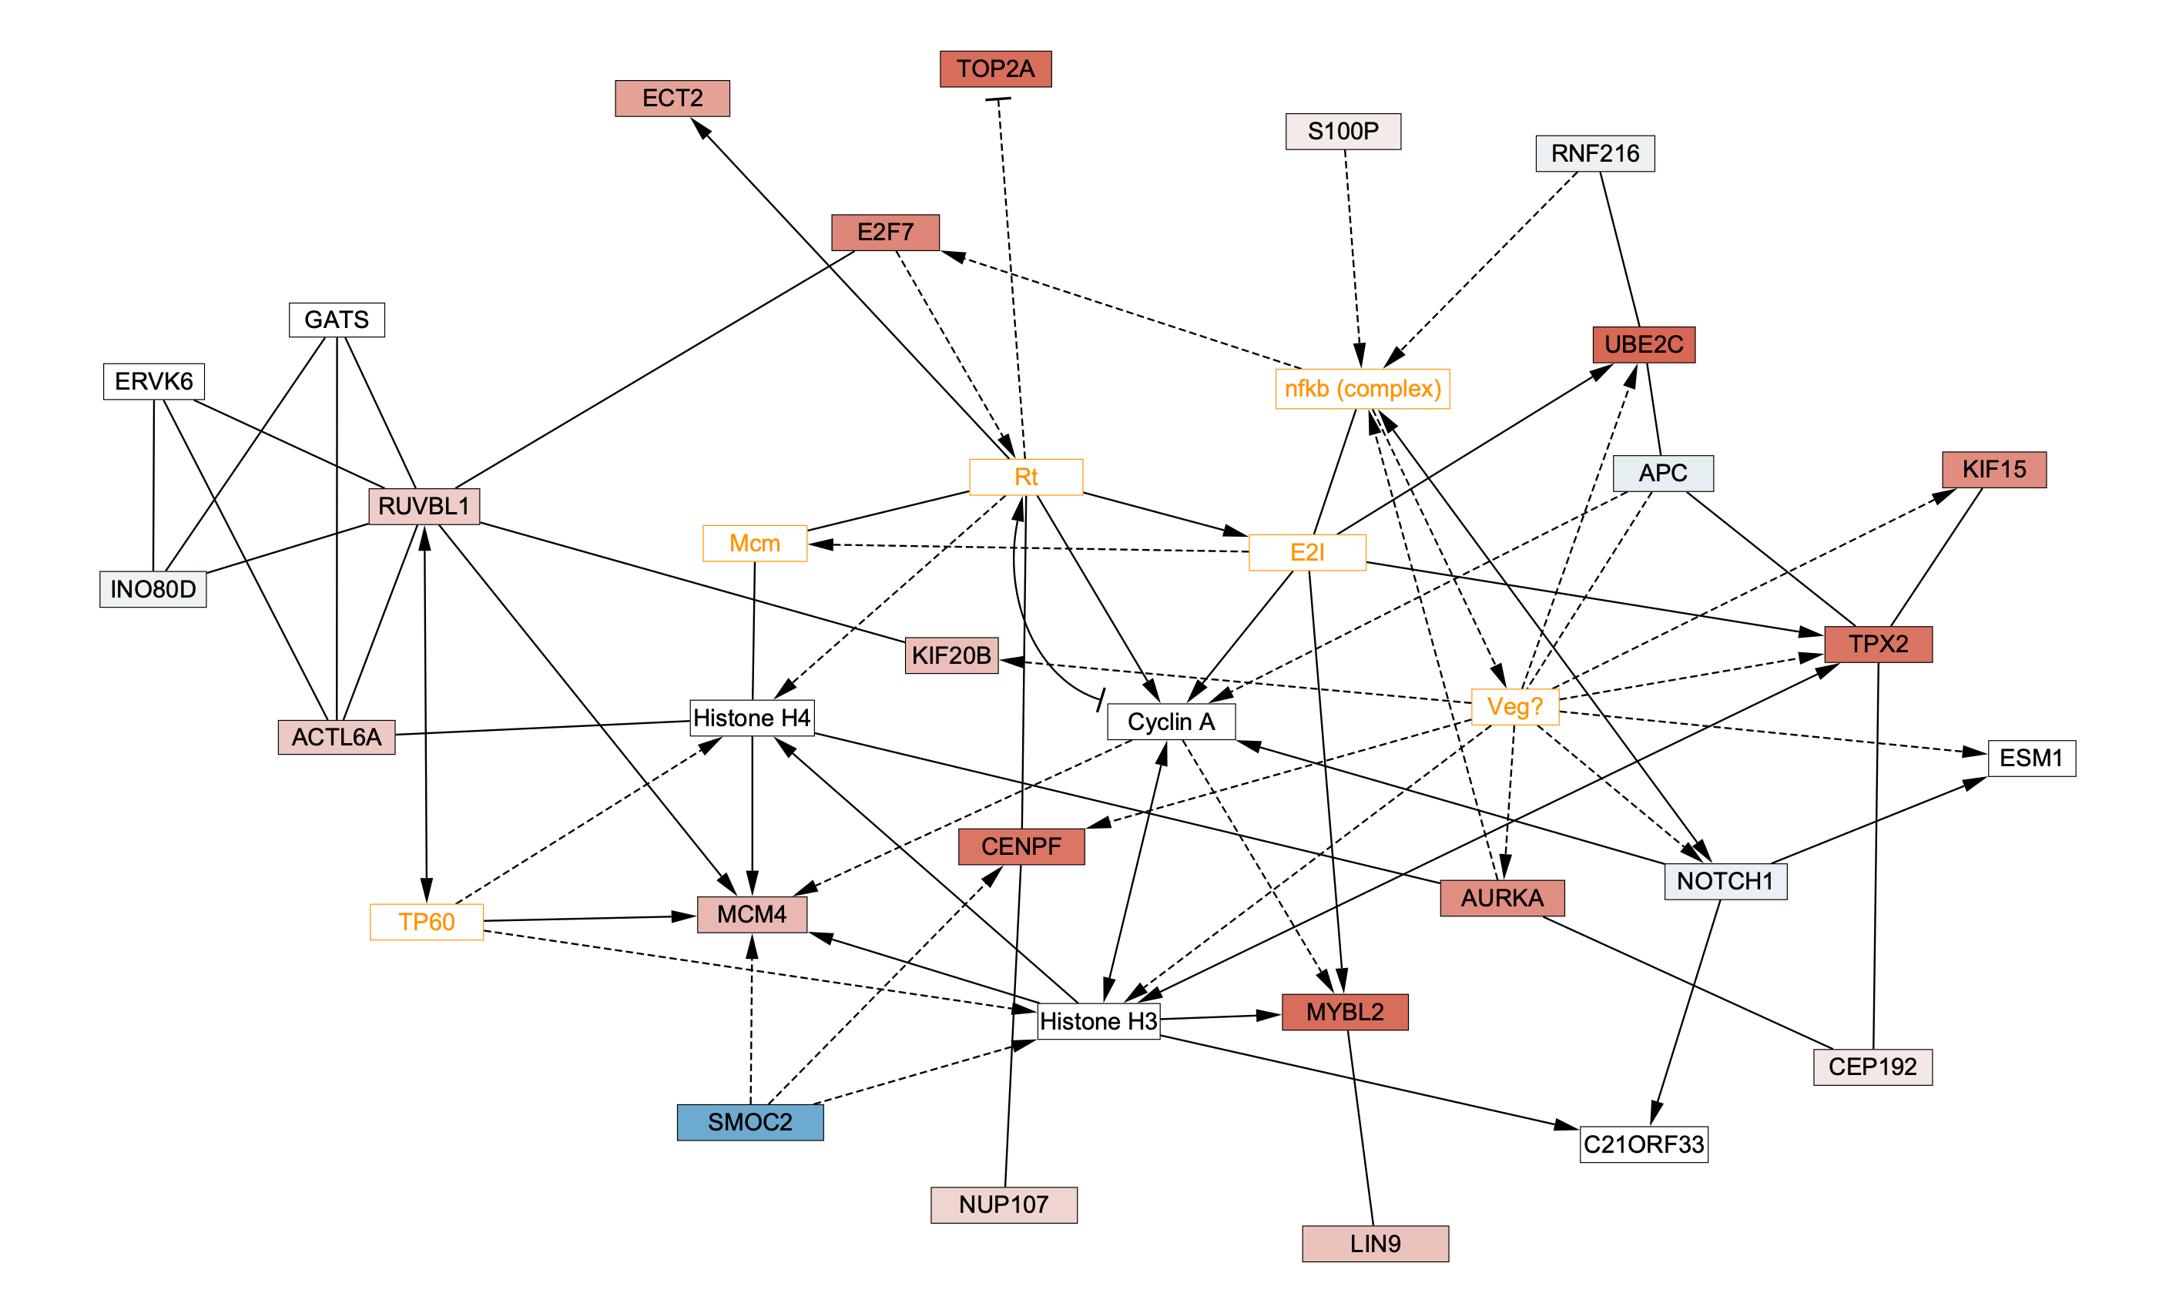
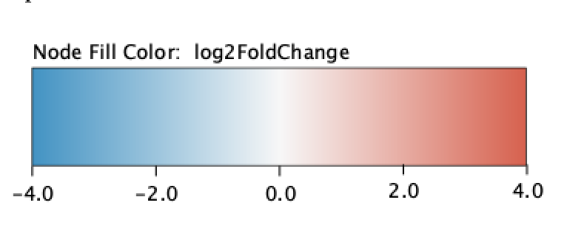
True Discovery Proportion (TDP) in Gastric Cancer Network 1
TDP_{s}: 0.72, TDP_{genome} :0.34

Slide 30
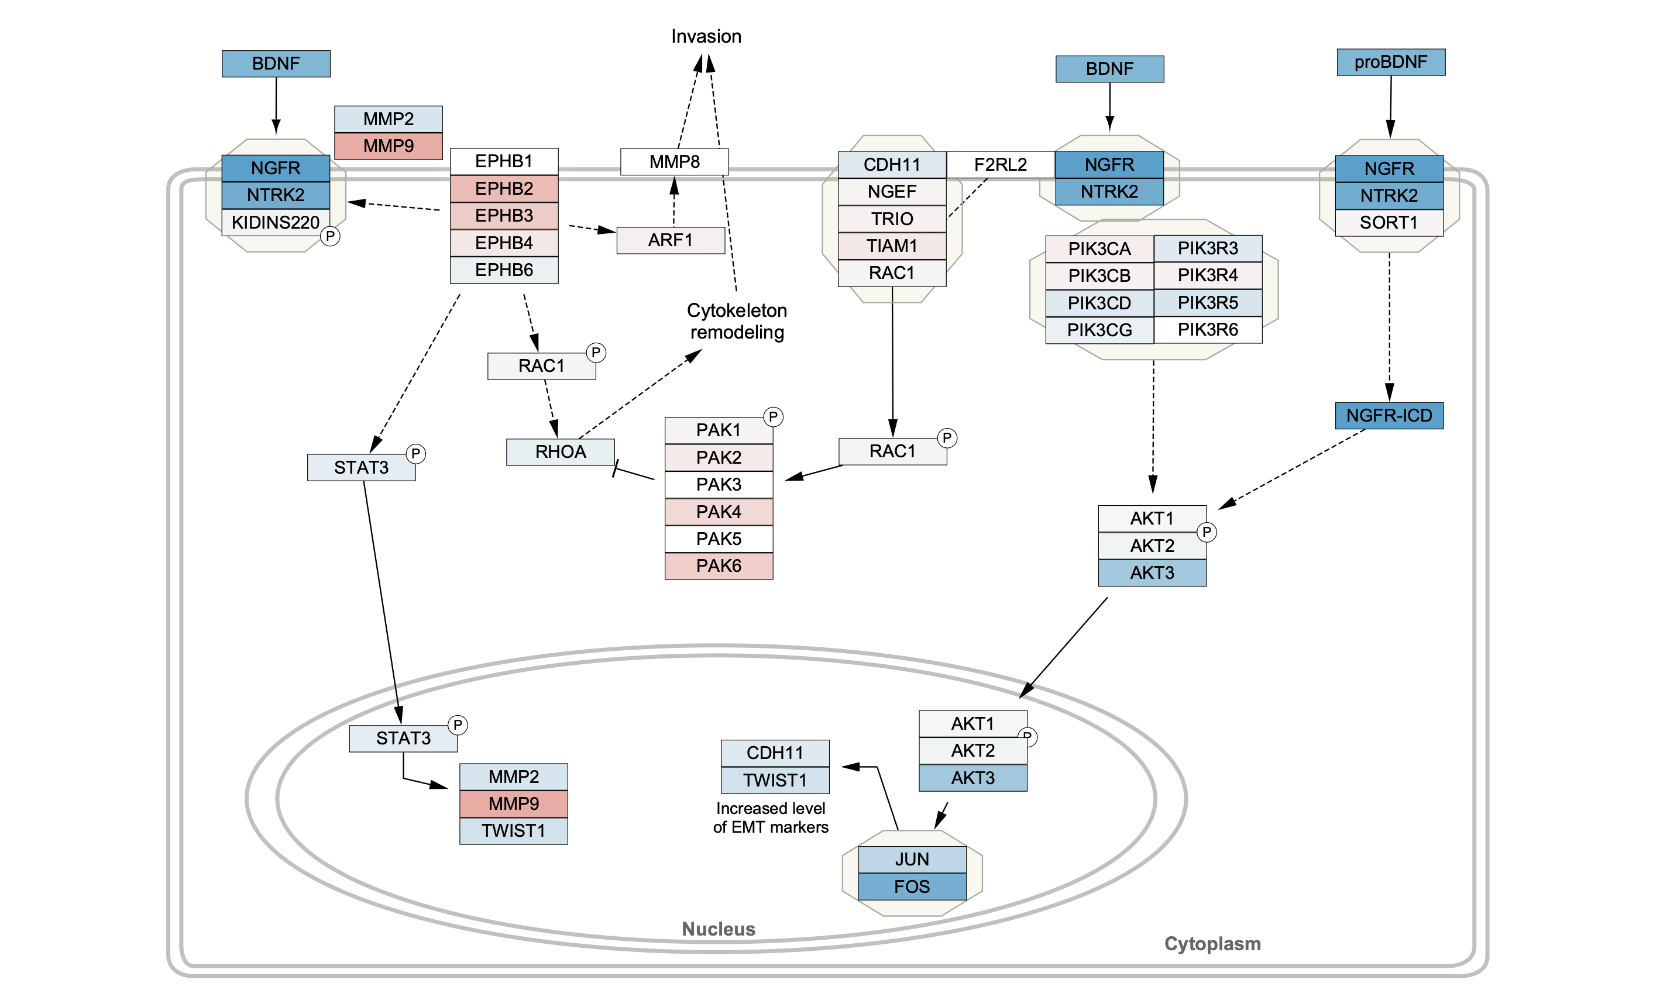
True Discovery Proportion (TDP) in Neural Crest Migration in Cancer
TDP_{s}: 0.17, TDP_{genome} :0.34

Slide 31
Odds ratio for Gastric Cancer Network1 Pathway
 | Differentially expressed | Not differentially expressed
In Gastric Cancer pathway | 16 | 6
Not in Gastric Cancer pathway | 1006 | 3811
Odds of finding a DE gene in the Gastric Cancer pathway = (16/22)/(6/22)=16/6
Odds of finding a DE gene not in the pathway =(1006/4817)/(3811/4817)=1006/3811
Odds Ratio = (16/6)/(1006/3811)=10.1

Slide 32
Odds ratio for Neural Crest Migration in Cancer Pathway
 | Differentially expressed | Not differentially expressed
In Neural Crest pathway | 6 | 30
Not in Neural Crest pathway | 1016 | 3787
Odds of finding a DE gene in the Neural Crest pathway = (6/36)/(30/36)=6/30
Odds of finding a DE gene not in the pathway =(1016/4803)/(3787/4803)=1016/3787
Odds Ratio = (6/30)/(1016/3787)=0.74

Slide 33
Average fold-change of genes in pathway
Gastric Cancer Network 1
Neural Crest Migration in Cancer

Slide 34
Outline and main messages
Context and background for enrichment methods
Primer on statistics
Statistics of Enrichment Methods
Choice of Parameter of Interest/Test statistic
Choice of Null Hypothesis
Sampling distribution of the Test statistic
Overview of the specific enrichment methods
Demo of the some methods in R
Guide to your choice of the method for your application
Questions

Slide 35
What should our null hypothesis be?
TDP_{s} = 0 OR TDP_{s} ≤ c
Average log2 fold-change = 0 OR |Average log2 fold-change| ≤ c
Odds Ratio = 1
Self-contained hypothesis (c = 0): You have a pathway in mind and want to know if these genes in this pathway have altered expression
Competitive hypothesis (c from genome): You are interested pathway whose genes are “more” altered than other genes not in the pathway

Slide 36
Question 4
Does the definition of Odds Ratio imply a Self-contained or a Competitive Hypothesis?
Respond to Poll
Competitive Hypothesis!
The odds of finding a differentially expressed gene in the Gastric Cancer Network 1 pathway is 10 times the odds of finding a differentially expressed gene not in this pathway

Slide 37
Outline and main messages
Context and background for enrichment methods
Primer on statistics
Statistics of Enrichment Methods
Choice of Parameter of Interest/Test statistic
Choice of Null Hypothesis
Sampling distribution of the Test statistic
Overview of the specific enrichment methods
Demo of the some methods in R
Guide to your choice of the method for your application
Questions

Slide 38
There is a story behind every p-value…
…that reflects how likely a given observation is under repeated attempts at performing a given experiment
…knowing what this experiment is critical to interpreting the significance of the p-value, here specifically in the context of enrichment analyses methods

Slide 39
Question 5
What kind of experiments would you like to be implicit in the estimation of p-values for enrichment of given pathways?
Respond to Poll
Ideally, one would want to go back find new bladder cancer patient samples, isolate their tumor and normal tissues and sequence their RNA and verify that the same pathways are enriched in these samples as well

Slide 40
Question 6
What is the implied experiment in the estimation of the significance Odds Ratio?
Respond to Poll

Slide 41
Gene permutation implicit in estimation of significance of odds ratio
Observed overlap of 2 altered genes with pathway genes
Pathway gene
1.
Altered gene
OR=Inf
Not pathway nor altered gene
Pemutation Possibilities of 2 altered genes across all genes
2.
9.
Probability of observing 2 altered genes
in the pathway = 3/15 = 20%
3.
OR=1
10.
4.
11.
OR=0
5.
12.
6.
13.
7.
14.
8.
15.

Slide 42
Implicit assumptions behind gene permutation used in ORA
Any gene can be swapped with any other gene: genes are independent of each other
Not a biologically valid assumption and it leads to elevated Type I error false positive rate
The resultant p-values do not represent the reproducibility of the results in terms of collection of new samples
Requires an a priori decision to made (e.g., FDR < 0.05) to decide on a set of differentially expressed genes
Despite all this, it is a quick method that does not perform “too badly” in practice

Slide 43
Sample permutations preserve gene-gene correlations
Observed expression of 2 altered genes
among 5 normal and 5 tumor samples
Sample permutation 1
Sample permutation 2
Gene 2
Gene 2
Gene 2
Gene 1
Gene 1
Gene 1
Normal sample
Tumor sample

Slide 44
Implicit assumptions behind sample permutation methods: rSEA, GSEA, SAFE, PADOG
Gene-gene correlation is preserved and therefore correct Type 1 error is maintained
Permutation of sample labels corresponds exactly with the null hypothesis for gene expression association (no change in expression between tumor and normal sample)
…this would imply a situation where you are resampling subjects from a population of bladder cancer patients with the assumption that there is no difference of the mean expression between the two groups
…therefore the results reflects their reproducibility
…drawbacks for methods that require explicit sample permutation
Need large number of replicates per group (at least 10)
Slow

Slide 45
Outline and main messages
Context and background for enrichment methods
Primer on statistics
Statistics of Enrichment Methods
Choice of Parameter of Interest/Test statistic
Choice of Null Hypothesis
Sampling distribution of the Test statistic
Overview of the specific enrichment methods
Demo of the some methods in R
Guide to your choice of the method for your application
Questions

Slide 46
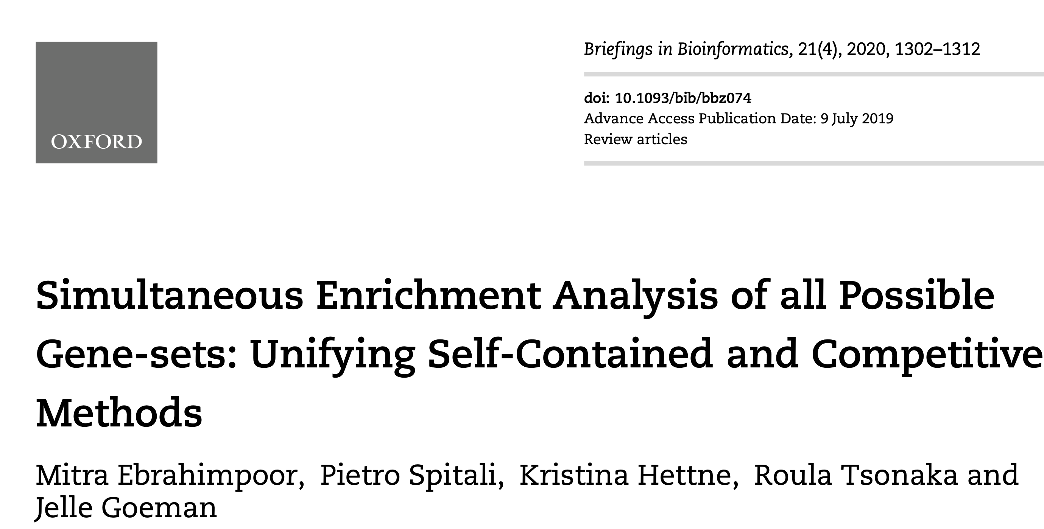
rSEA
For each gene set s,
Null hypothesis
TDP_{s} ≤ c
Choice of c determines the kind of hypothesis
c = 0: Self-contained
c = TDP_{genome} : Competitive
Significance estimates using closed set testing – one of the many multiple testing methods
Type I error is correctly maintained!

Slide 47
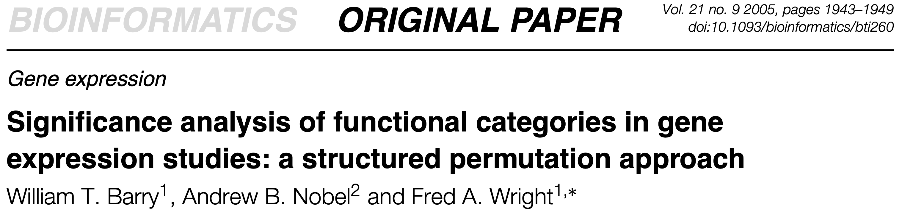
SAFE
Gastric Cancer Network 1
For each gene set s,
Null hypothesis
Mean log2FC among genes in set s = Mean log2FC among genes not in s
Sample permutation to estimate significance
Type I error is correctly maintained!

Slide 48
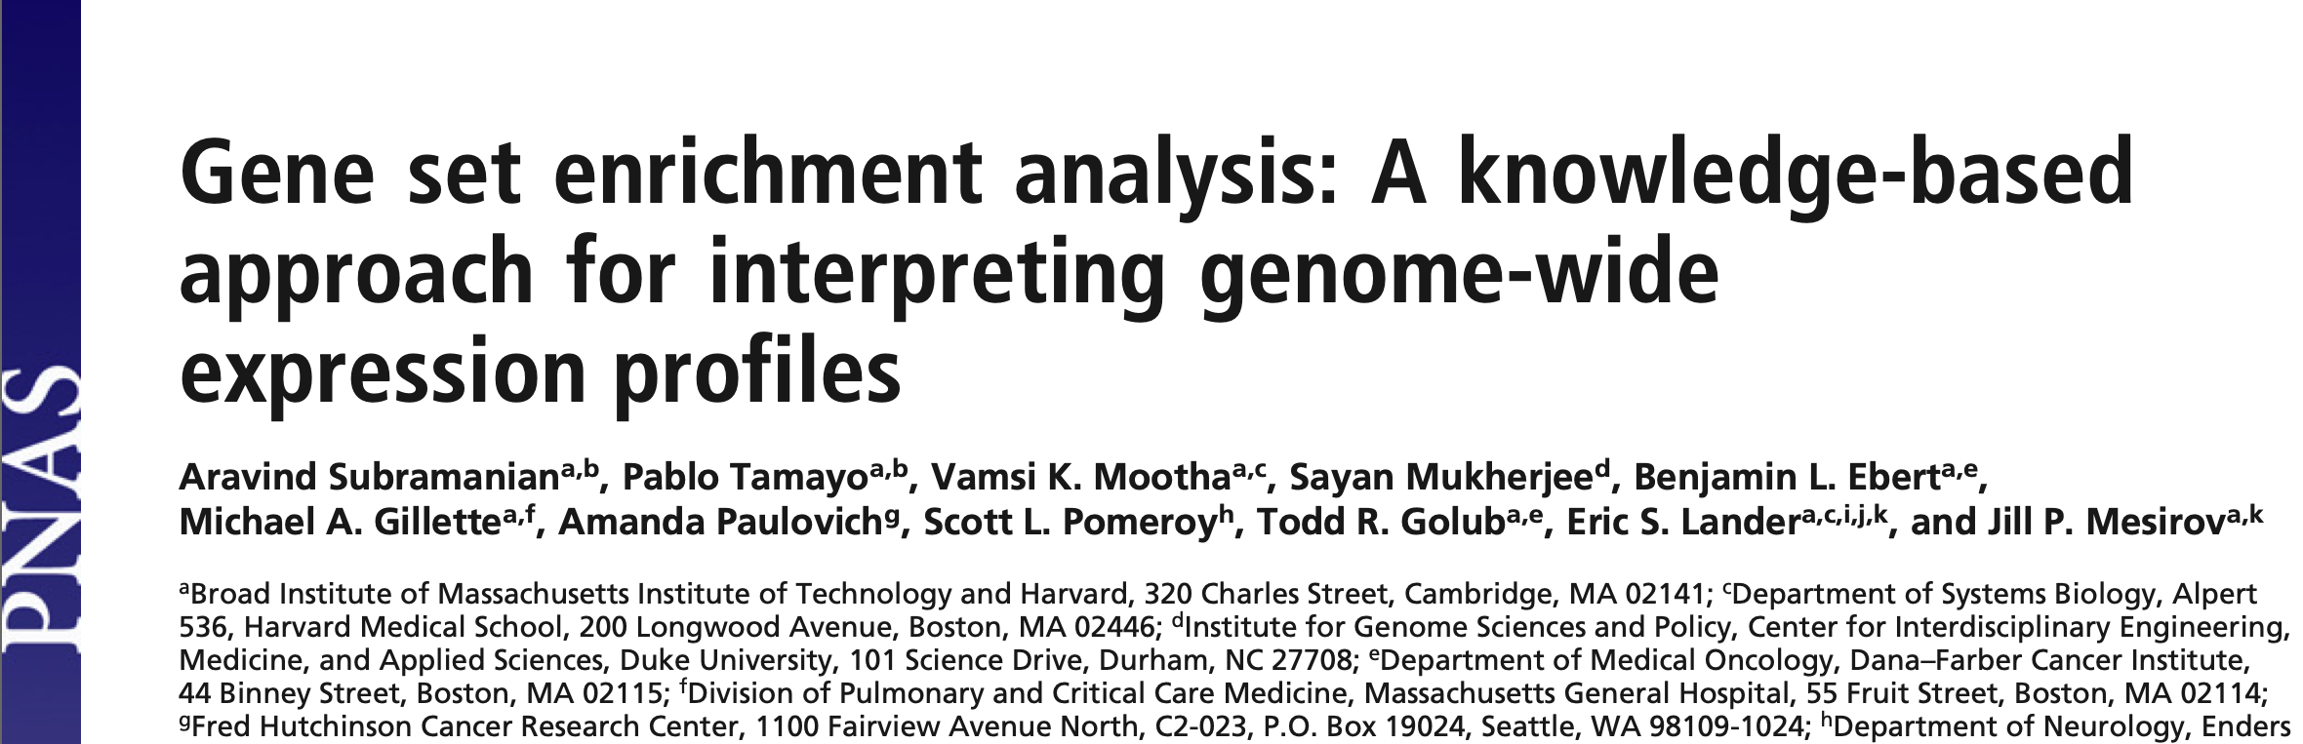
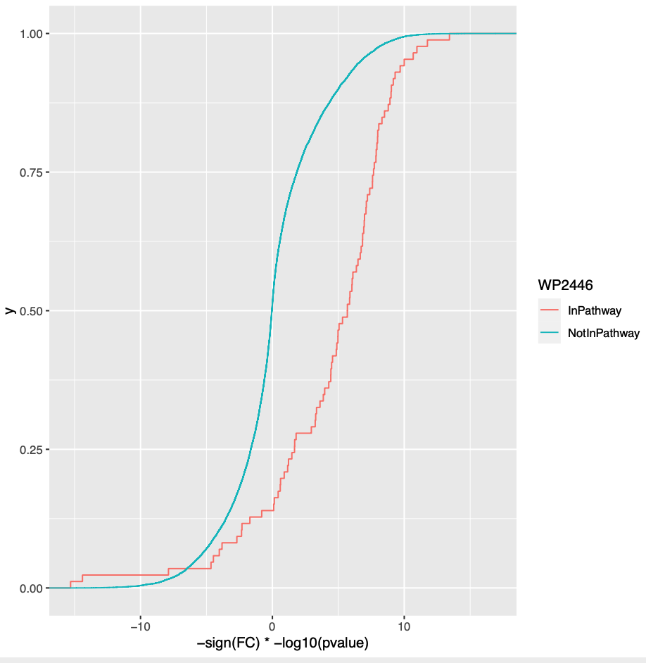
GSEA
For each gene set,
Null hypothesis
F(S) = F(S^{c})
F(S): distribution of “correlation” of gene expression with phenotype among genes in set S
F(S^{c}): distribution of “correlation” of gene expression with phenotype among genes not in set S
Enrichment Score (ES)
-1 ≤ ES ≤ 1
Probability
Can use gene or sample permutation to estimate
significance
Correlation

Slide 49
Over Representation Analyses
ORA
 | Differentially expressed | Not differentially expressed
In Gastric Cancer pathway | 16 | 6
Not in Gastric Cancer pathway | 1006 | 3811
Odds of finding a DE gene in the Gastric Cancer pathway = (16/22)/(6/22)=16/6
Odds of finding a DE gene not in the pathway =(1006/4817)/(3811/4817)=1006/3811
Odds Ratio = (16/6)/(1006/3811)=10.1
For each gene set s,
Null hypothesis
Odds Ratio = 1
Significance is evaluated using the Hypergeometric Distribution/Fisher’s Exact Test

Slide 50
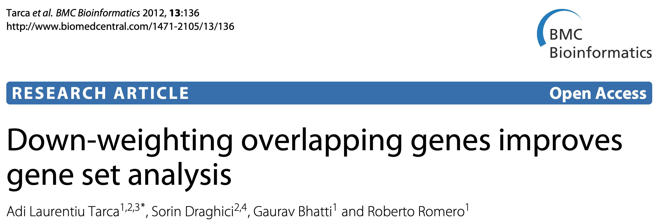
PADOG
Some genes are part of many WikiPathways
For each gene set s,
Null hypothesis
Mean weighted |log2FC| among genes in set s =
Mean weighted |log2FC| among genes not in s
Sample permutation to estimate significance
Type I error is correctly maintained!

Slide 51
Required multiple testing correction of significance estimates from different gene sets
Increased number of false-positives gene set associations very likely if we do not correct for multiple testing
Can use FDR, Holm-Sidak based corrections

Slide 52
Outline and main messages
Context and background for enrichment methods
Primer on statistics
Statistics of Enrichment Methods
Choice of Parameter of Interest/Test statistic
Choice of Null Hypothesis
Sampling distribution of the Test statistic
Overview of the specific enrichment methods
Demo of the some methods in R
Guide to your choice of the method for your application
Questions

Slide 53
Outline and main messages
Context and background for enrichment methods
Primer on statistics
Statistics of Enrichment Methods
Choice of Parameter of Interest/Test statistic
Choice of Null Hypothesis
Sampling distribution of the Test statistic
Overview of the specific enrichment methods
Demo of the some methods in R
Guide to your choice of the method for your application
Questions

Slide 55
Criteria on deciding the enrichment tests for your research - I
You have a specific pathway that is the focus of your research - Use methods that test self-contained hypothesis (rSEA with c = 0).
You do not have a specific pathway that is the focus of your research - Use methods that test competitive hypothesis.
You just have a list of genes of interest and are interested in finding out associated pathways - Use ORA
You would like the significance of the gene set enrichment method to reflect the reproducibility of result across multiple re-sampling of study subjects and the number of replicates per group is less than 10 – Use rSEA

Slide 56
Criteria on deciding the enrichment tests for your research - II
You would like the significance of the gene set enrichment method to reflect the reproducibility of result across multiple re-sampling of study subjects and the number of replicates per group is greater than 10 and you have access to good computing resources – use SAFE, PADOG with sample permutation
If you do not have access to good computing resources – use rSEA
If you have just a scored genome-wide list of genes and are interested in identifying associated pathways – use GSEA with gene permutation

Slide 57
Criteria on deciding the enrichment tests for your research - III
Permutation-based methods are non-parametric, i.e., make least number of assumptions about the data distribution – if adequate number of replicates available then best methods to use
Methods like ORA, rSEA, GSEA with gene permutation are dependent on the validity of the assumptions for calculation of the significance of association of individual genes – check assumptions

Slide 58
Please fill-out survey
https://www.surveymonkey.com/r/F75J6VZ

